Slide 1
Beamforming in PDSCH for 5G Group 3 Mentored by Abhijeet Sir
Enhancing Data Rates and Signal Quality in 5G Networks

Slide 2
Contents
Introduction to Beamforming in 5G
Objectives of Beamforming in 5G
Beamforming Principles in 5G NR
Beamforming Algorithm
Performance Analysis: PDSCH with and without Beamforming
Impact of Beamforming on 5G Networks
Challenges and Considerations
Conclusion
Code

Slide 3
Presented by
Bhakti S
Ranjita Karadad
Ritesh Mishra
Vaidehi Shailendra Bhosale
Vanaja Dukka
Vivek Kumar
Yash Pramod Gulhane
Yengala Dharmendra Kumar Reddy

Slide 4
Introduction to Beamforming in 5G
Beamforming, as its name suggests is the “forming” of a “beam” of RF energy. Fundamentally, the electromagnetic wave radiation pattern from a system is focused like a beam from a torch (or laser).
Beamforming is a key technology in 5G that focuses radio signals in a specific direction, enhancing data rates and coverage.
Beamforming focuses radio signals on specific users or areas to efficiently concentrate energy where it's needed most.
Beamforming optimizes the signal's path to:-
-Improve coverage and data rates.
-Enhance network capacity.
-Overcome challenges like signal interference and high-frequency signal attenuation.
In 5G NR(New Radio), Beamforming play a key role like:-

Slide 5
-Efficient Use of Spectrum-Beamforming allows more precise signal direction, maximizing the available spectrum and enabling simultaneous transmission of more data.
-Increased Network Capacity: Beamforming increases the overall capacity of 5G networks by enabling multiple users to share the same frequency band without significant interference.
-Overcoming High-Frequency Challenges: Beamforming helps address issues related to high-frequency signals, such as greater signal weakening and susceptibility to interference, ensuring reliable and high-quality connections.
Benefits of Beamforming:-
-Beamforming improves the uplink and downlink link budgets by increasing the antenna gain, especially in higher operating bands with greater air-interface attenuation.
-It reduces inter-cell interference by focusing transmission in a specific direction with a relatively narrow beamwidth.
-This helps to support multi-user MIMO by allowing multiple users to share the same Resource Blocks when they are spatially separated. In such cases, multiple simultaneous beams transmit the same Resource Block with different payloads in different directions.

Slide 6
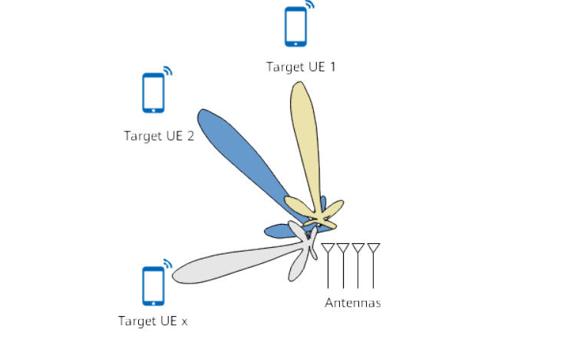
Diagram of Beamforming

Slide 7
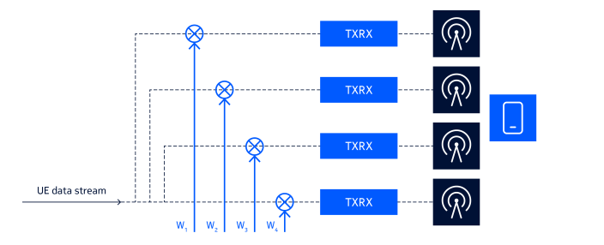
Beamforming is a downlink multiple-antenna feature introduced since 3GPP Release 8
When beamforming is enabled, an gNodeB weights physical downlink shared channel (PDSCH) data to form a narrow beam towards target UEs, increasing the signal-to-noise ratio (SNR) for demodulation and improving user experience at the cell edge.
Type of Beamforming:-
Digital Beamforming: Uses digital signal processing to steer and shape the beam.

Slide 8
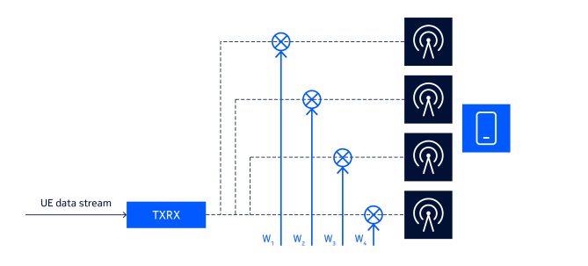
2. Analog Beamforming:-Uses analog circuits to control the phase and amplitude of the signal.
Analog Beamforing

Slide 9
Objectives of Beamforming in 5G
Enhance Data Transmission:- It focused on Signal Delivery. Beamforming improves data transmission by directing signals straight to the intended users, reducing interference and signal loss.
Optimize Spectrum Efficiency:- It maximize Bandwidth Utilization, With beamforming, signal energy is focused in specific directions, allowing multiple users to share the same frequency spectrum without causing interference, and making better use of available bandwidth.
Improve Coverage and Capacity:-Wider Network Reach- Beamforming extends the reach of 5G networks by improving signal strength and quality in specific areas, especially in challenging environments like dense urban areas.
Increase Network Capacity:-This technique enables higher data rates and more simultaneous connections, improving the overall capacity of 5G networks.

Slide 10
Overcome High-Frequency Limitations: Reduce Signal Attenuation- High-frequency 5G signals, especially in millimetre-wave bands, are prone to attenuation and obstacles. Beamforming helps overcome these challenges by focusing the signal directly toward the user, ensuring a more reliable connection.

Slide 11
Principles of Beamforming in 5G NR
Principle of Beamforming:-
1.RRU Channel Calibration: Calibrating the Remote Radio Unit (RRU) channels to ensure accurate phase and amplitude alignment across antenna elements.
2.Weight Calculation:-Calculating the optimal weights (phase and amplitude) for each antenna element to form the desired beam pattern.
3. Weighting: Applying the calculated weights to the signal at each antenna element to shape the beam.
4. Beamforming Implementation: Combining the weighted signals from each antenna element to form the final beamformed signal.
5. Demodulation: Receiving and demodulating the beamformed signal at the user equipment (UE) to recover the original data.

Slide 12
These steps enable the 5G NR base station to:
Create a focused beam towards a specific user or area
Increase signal strength and quality
Improve link reliability and throughput
Reduce interference and noise
By following these steps, beamforming in 5G NR can support advanced use cases like massive MIMO, millimetre wave (mmWave), and ultra-reliable low-latency communications (URLLC).
Application in PDSCH:-
Improved Signal Quality and Faster Data: In the Physical Downlink Shared Channel (PDSCH), beamforming is crucial for making sure that users receive the strongest signal, leading to faster data transmission and better signal quality.
Essential for Fast Data in Busy Cities: In crowded urban areas with lots of users and interference, beamforming is critical for maintaining signal quality and supporting the high data rates needed for 5G services. It does this by directing the signal precisely, reducing the impact of obstacles and interference.

Slide 13
3. Support high-data-rate applications: Beamforming enables the high-data-rate transmissions required for applications like video streaming, online gaming, and virtual reality.
4. Increase network capacity: By improving link quality and spectral efficiency, beamforming enables the network to serve more users and devices.
5. Reduce interference: Beamforming minimizes interference between adjacent cells and users, improving overall network performance.
In PDSCH, beamforming is used in conjunction with other 5G NR technologies like:
Massive MIMO: Beamforming is used to optimize the transmission and reception of signals in massive MIMO systems.
Millimeter wave (mmWave): Beamforming helps overcome the propagation losses and interference associated with mmWave frequencies.
OFDM (Orthogonal Frequency Division Multiplexing): Beamforming is applied to the OFDM symbols transmitted in PDSCH to improve link quality and throughput.
*By Using beamforming in PDSCH, 5G networks can deliver faster, more reliable, and higher-quality connectivity, supporting a wide range of use cases and applications.

Slide 14
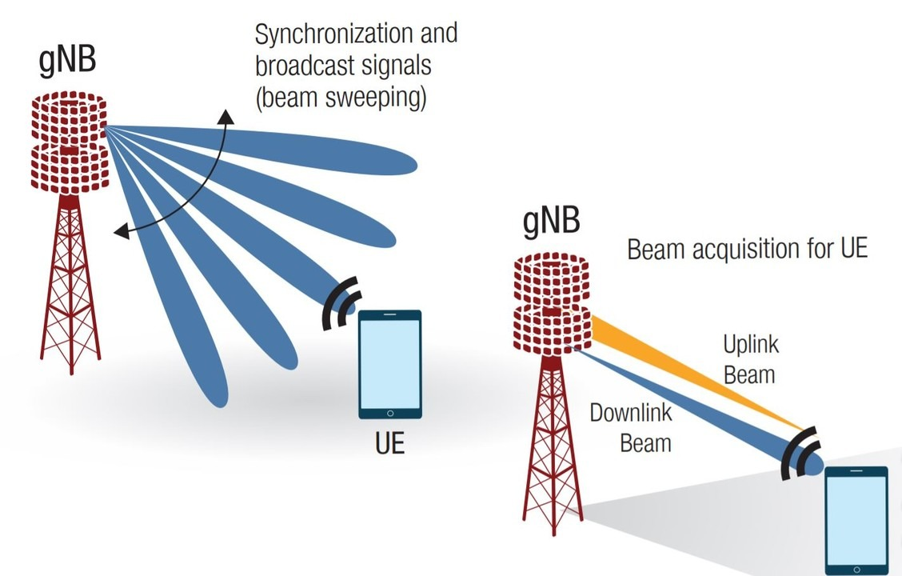

Slide 15
Beamforming Algorithm in PDSCH for 5G
Initialization:-
-System setup:-Initialize the Remote Radio Unit (RRU) and User Equipment (UE) parameters, including antenna configurations, channel characteristics, and initial UE position.
-Calibration-Perform RRU channel calibration to ensure accurate phase and amplitude control across the antenna array.
Weight Calculation:-
-Channel State Information (CSI): Gather CSI from the UE, which provides detailed information on the current state of the communication channel.
-Beamforming Weights: Calculate the beamforming weights based on the CSI. These weights determine the phase and amplitude adjustments needed for each antenna element to direct the beam toward the UE.

Slide 16
Signal Weighting:-
-Apply Weights: Modulate the signal with the calculated beamforming weights, adjusting the phase and amplitude for each antenna element in the array.
-Weighted Signal Transmission: The weighted signals are transmitted from the RRU, creating a focused beam directed at the UE.
Beam Direction Adjustment:-
-UE Movement Tracking: Continuously monitor the UE’s position and movement. Adjust the beamforming weights dynamically to maintain the beam’s focus on the UE as it moves within the network.
-Feedback Loop: Use real-time feedback from the UE, such as Signal-to-Noise Ratio (SNR) or Channel Quality Indicator (CQI), to refine the beam direction and strength.
Beamforming Implementation:-
-Signal Transmission: The RRU transmits the weighted and focused signal toward the UE. The beamforming process ensures that the signal is concentrated in the direction of the UE, enhancing signal strength and reducing interference.
-Handling Interference: The algorithm also considers interference from other users or environmental factors, adjusting the beam to minimize its impact.

Slide 17
Demodulation and Feedback:-
-Signal Reception at UE: The UE receives the focused signal and demodulates it to extract the transmitted data.
-Quality Feedback: The UE provides feedback on the received signal quality, which is used to adjust the beamforming weights in subsequent transmissions, further optimizing the beam's direction and strength.
Performance Optimization:
-Continuous Improvement: The algorithm continuously refines the beamforming process based on UE feedback and changes in the environment, ensuring optimal performance throughout the PDSCH transmission.
5G PDSCH beamforming also employs techniques like:
- Hybrid beamforming: Combines analog and digital beamforming
Millimeter wave (mmWave) beamforming: Optimizes beamforming for mmWave frequencies
Massive MIMO beamforming: Optimizes beamforming for large-scale antenna systems

Slide 18
Performance Analysis: PDSCH with and without Beamforming
With Beamforming:-
Enhanced SNR: Beamforming significantly improves the Signal-to-Noise Ratio (SNR) by focusing the signal toward the UE, resulting in clearer and stronger transmissions.
Higher Data Rates: The concentrated signal strength allows for higher data rates, enabling faster and more reliable data transmission in PDSCH.
Raduced Error Rates: The focused beam reduces interference and signal degradation, leading to lower error rates and more accurate data reception.
Increased Coverage: Extended coverage area due to increased signal strength.
Enhanced User Experience: Better overall performance and quality of service.

Slide 19
Without Beamforming:-
Lower SNR: Without beamforming, the signal is broadcast uniformly, leading to lower SNR, especially for UEs located farther from the RRU or in high-interference areas.
Decreased Data Rates: The lack of focused signal delivery results in reduced data rates, particularly in challenging environments.
Higher Error Rates: Uniform signal broadcasting increases the likelihood of interference and signal degradation, leading to higher error rates./ Increased errors in data transmission due to poor signal quality.
Limited Coverage: Reduced coverage area due to lower signal strength.
Lower Throughput: Reduced data transfer rates due to poor signal quality.

Slide 20
Impact of Beamforming on 5G Networks
Improved Coverage and Capacity: Beamforming increases signal strength and quality, expanding coverage and enabling more users and devices to be served.
Increased Data Throughput: Beamforming enables faster data transfer rates, supporting high-bandwidth applications like video streaming and online gaming.
Reduced Interference: Beamforming minimizes interference from adjacent cells and users, improving overall network performance.
Enhanced Spectral Efficiency: Beamforming optimizes spectrum usage, allowing more data to be transmitted over the same frequency band.
Reduced Interference: Beamforming minimizes interference from adjacent cells and users, improving overall network performance.
Better User Experience: Beamforming ensures a more reliable and consistent connection, enhancing the overall user experience.

Slide 21
Support for Massive MIMO: Beamforming is essential for massive MIMO (Multiple-Input Multiple-Output) technology, which enables the use of large-scale antenna arrays.
Millimeter Wave (mmWave) Support: Beamforming helps overcome the propagation losses and interference associated with mmWave frequencies.
Ultra-Reliable Low-Latency Communications (URLLC): Beamforming enables the low-latency and high-reliability required for URLLC use cases like autonomous vehicles and smart grids.
Network Energy Efficiency: Beamforming can help reduce power consumption by optimizing signal transmission and reception.
New Use Cases and Applications: Beamforming enables new use cases like precise positioning, asset tracking, and immersive technologies.

Slide 22
Challenges and Considerations
Challenges in Implementation:
*Accurate UE Positioning:-
-Issue: Precise beamforming relies on accurate location data of the User Equipment (UE). Errors in positioning can lead to suboptimal beam alignment and reduced performance.
-Solution:- Implement advanced positioning techniques and refine algorithms to improve accuracy and reliability in various environments.
*Handling Dynamic Environments:-
-Issue: In real-world scenarios, UEs may move frequently, and environmental conditions can change rapidly, affecting beamforming effectiveness.
-Solution: Develop adaptive algorithms that can quickly adjust beam direction and strength based on real-time data and environmental changes.

Slide 23
Considerations for future work:-
*Integration with Advanced Techniques:
-Massive MIMO: Combine beamforming with Massive Multiple Input Multiple Output (MIMO) technology to further enhance capacity and coverage. This integration can leverage a larger number of antennas for more precise beamforming and better spatial multiplexing.
-Advanced Algorithms:- Explore sophisticated algorithms for accurate beamforming, including machine learning approaches for dynamic adaptions.
*Real-Time Implementation:
-Deployment: Transition from simulation to real-world deployment in 5G networks. Address practical challenges such as hardware limitations, signal interference, and real-time processing constraints.
-Testing and Optimization: Conduct extensive field tests to validate the algorithm’s performance and make necessary adjustments for optimal operation in diverse network conditions.

Slide 24
Conclusion
Summary of Key Points:-
Beamforming plays a crucial role in 5G NR, particularly for PDSCH (Physical Downlink Shared Channel).
The implemented beamforming algorithm significantly enhances performance in terms of throughput, coverage, and capacity.
Final Thoughts:-
Beamforming as a cornerstone: Beamforming is a fundamental technology for future 5G enhancements, enabling faster, more reliable, and more efficient connectivity.
Ongoing research and optimization: Continued research and optimization are necessary to fully realize the potential of beamforming in real-world 5G applications, addressing challenges like dynamic environments and scalability.

Slide 25
Code

Slide 26
Thank You

